Slide 1


Fire Warden Training (Alii Place)
Presented by Allied Universal – Jeremy Madrid

Slide 2
Overview
Planning for an emergency
Fire indicators
Responsibilities of a Fire Warden / Searchers | Buddies
Fire Systems
Evacuation Plan

Slide 3
Planning for an Emergency
WHAT IS AN EMERGENCY?
An Emergency is “ an event, actual or Imminent, which endangers or threatens to endanger life, property or environment, and which requires a significant and coordinated response”

Slide 4

Planning for an Emergency Action Plan
WHAT IS AN EMERGENCY ACTION PLAN ?
In the event of an emergency, follow your establish action plan. An emergency action plan contains “designated actions that employers, employees, and other building occupants should take to ensure they are safe from fire and other emergencies.”

Slide 5

Planning for an Emergency (Emergency Response Team)
Emergency Response Team
The Emergency Response Team helps implement the Emergency Action Plan. The Emergency Response Team monitors and reports hazards, responds to emergencies and aids in the safe evacuation of occupants.
Each member of the Emergency Response Team should be equipped with safety vest; a whistle and flashlight are also recommended. When an alarm sounds, the Emergency Response Team should immediately put on their vest and be prepared to lead and direct others. Working together, the team should effectively guide area occupants into the designated stairwell(s) and proceed to evacuate.

Slide 6
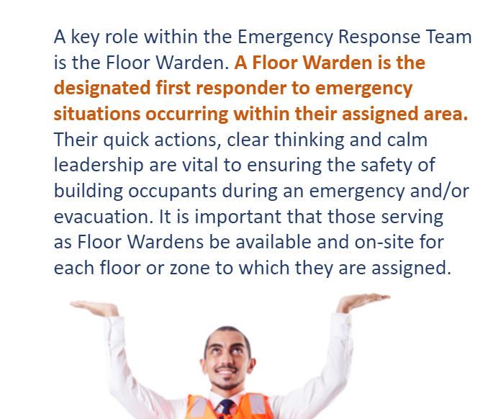
What is a Floor Warden?

Slide 7
Fire Warden Responsibilities
Know the Building’s Fire Warden Manual
Know employees that are unable to evacuate on foot (this list should be updated as needed and sent to building management)
Know Locations of all exits
Knowledgeable of Fire Alarm System & Evacuation Protocols.
Know location and operation of available Fire Extinguishing Equipment
Know your emergency phone numbers
Be responsible for fire prevention
Nominate Persons for emergency positions
Communicate emergency procedures to all employees you are responsible for.
Execute a calm evacuation - ensuring everyone is accounted for.
Take a head count at the Assembly location and report any missing individuals to Emergency personnel or management.
Conduct Monthly Fire Inspections for potential hazards.
Notes:
-Keep copies of the building emergency plan in a quick access area. Or place it in a go-bag (Emergency-bag) for an easy grab and go.

Slide 8
Tenant Representatives – Searchers & Buddies
Searchers
Prefer 2 males and 2 females.
Will need to search all areas within the office to ensure that no one is left behind (breakrooms, kitchens, personal offices, conference rooms etc.)
Restrooms located on the building level will also need to be inspected.
All doors must be closed
Inform the Fire Warden that the assigned areas were clear and evacuated.
Direct everyone to the stairwells.
Buddies
Impaired: Anyone who can not walk down one flight of stairs unassisted.
Each impaired person must be assigned a designated Buddy. Buddies should have some knowledge of their person’s disability.
Buddies are to assist their assigned disabled person to the waiting area located in the landing of the Fire Exit Stairwells and remain with them until HFD arrives for assistance. Please note the floor they are on and that the information is provided to HFD or management.
Notes:
A closed door means more lives saved. Make a 900 degree difference. Many people actually sleep with their doors open. Having a closed door will protect you from heavy smoke and elevated temperature from a fire.

Slide 9
Indication of Fire (Example Scenarios)
Scenario 1) Smoke/Flames/Odor/Active Fire Alarm.
Scenario 2) unfamiliar odor/ Investigating a potential fire.
*While calling Emergency Personnel - is it imperative to gather the information below:
Call the Fire Department Immediately 9-1-1
Contact Fire Director: Building Management – Office: 808.523.1599 Security: 808.226.7599
If Alarm is not activated: Find the nearest Pull Station and activate an alarm.
Report any changes in the condition of the fire to the management & Emergency personnel.
Call the Fire Safety Director: 808.523.1599
Emergency building personnel (Engineering & Security) will investigate the odor and determine if it is in fact an imminent fire.
Be prepared to evacuate if an Imminent fire is expected in your workspace.
What Is your emergency? (Alarm/smell of smoke/visible smoke and Flames. Etc.)
Specific address location. (indicate suite number, Floor Level/ What area of the floor in the suite you are calling about.)
Type of occupancy (Commercial Space)
Your telephone call back #
Listen to dispatcher- Let the dispatcher hang up first.

Slide 10
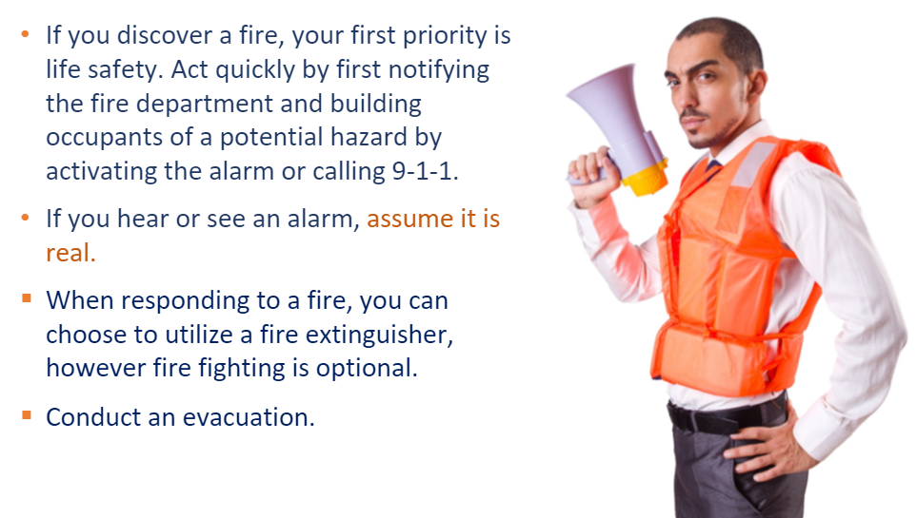
Responding to a fire
Responding to a fire in your space/floor | Evacuation key-pointers.
Use the back of your hand to inspect a door that is in question. Never grab a door-knob with your palm.
If the Building Fire Alarm System has not been activated, activate the pull-stations.
Know your team members that are not able to walk down the stairs.
Remind the team to carry only the essentials during the evacuation.
Isolate the Fire- Close any doors that may prevent the spread of the fire.
Evacuate calmly to the evacuation zone.

Slide 11
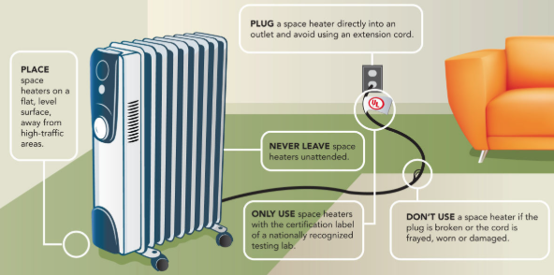
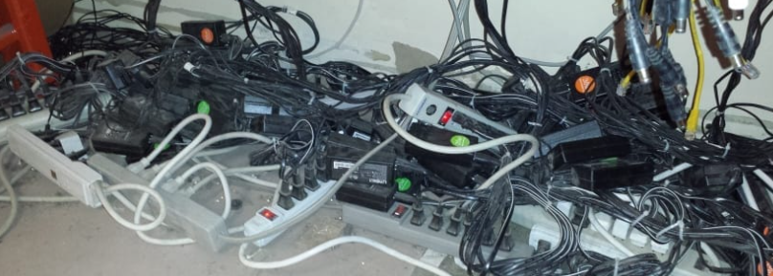
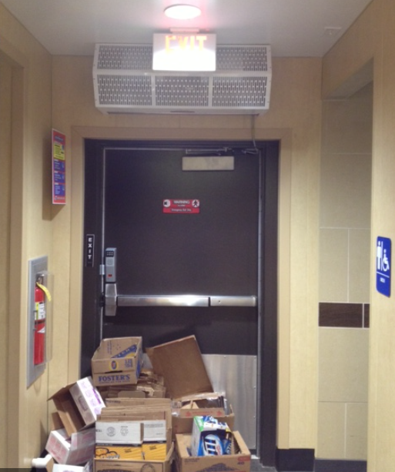
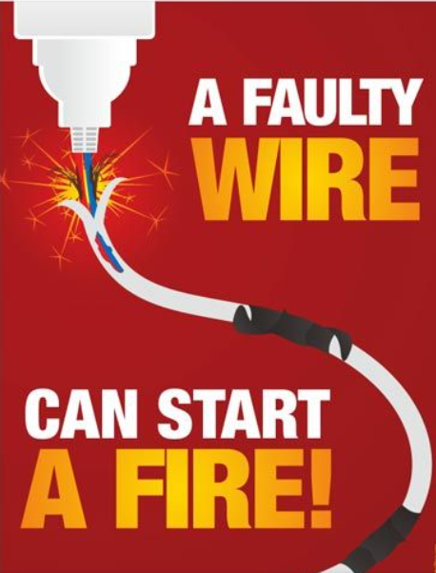
Fire Prevention Tips
Do not smoke
Do not smoke anywhere on property- Please use designated smoking areas.
Do not pile
Do not pile trash or combustible-materials in your office space, especially near the fire exit doors.
Dispose
Dispose of all ashtrays and smoking materials properly.
Do not use
Do not use extension cords as a substitute for Permanent wiring.
Do not light
Do not light any candles (No open flame policy)
Do not store or stack
Do not store or stack materials in front of telephone equipment or electrical panels.
Do not prop
Do not prop open any suite doors or exits.
Unplug and repair
Unplug and repair all faulty electrical equipment
Do not place
Do not place combustible materials near heat-producing devices

Slide 12


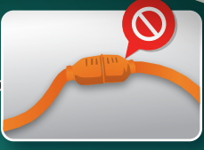
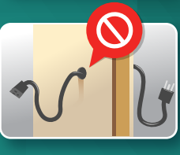


Electrical Safety (Extension Cords)
Do not attempt
Do not attempt to plug extension cords into one another (daisy chaining)
Do not overload
Do not overload extension cords
Do not plug
Do not plug appliances into an extension cord
Do not nail or staple
Do not nail or staple electrical cords to walls or baseboards
Passing Through Wires
Do not run your wires through walls, doorways, carpets- If cords are covered heat cannot escape – which may result in a fire.
Purchase
Purchase chords that are approved by a testing laboratory. US market – UL,ETL,CSA certified cords. Nationally Recognized by OSHA.
Inspect
Inspect cords for damage before use. Check for cracked or frayed sockets, loose or bare wires and loose connections.

Slide 13
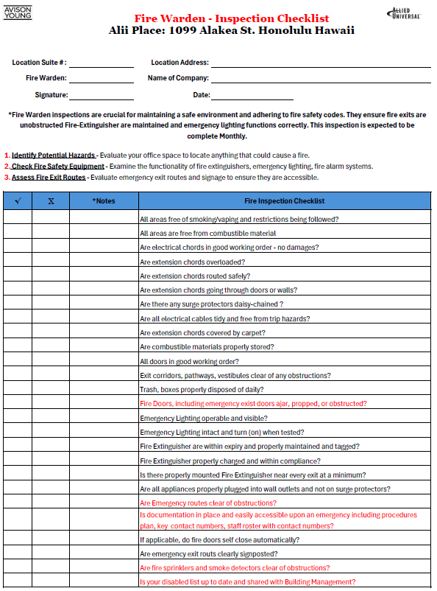
Fire Warden Inspections
*Fire Warden inspections are crucial for maintaining a safe environment and adhering to fire safety codes. They ensure fire exits are unobstructed Fire-Extinguisher are maintained and emergency lighting functions correctly. This inspection is expected to be completed Monthly.
Are Chords in Good working order, do we have any piggy-backed power strips/ Surge protectors?
Enforcing smoking ordnance including vaping.
All Combustible materials must be store in protective areas
Empty Boxes and trash should be disposed daily (Use trash stickers)
All doors should not be obstructed, propped open, left ajar.
Exit corridors such as pathways, vestibules leading to the fire exit must be clear and accessible.
Emergency Exit Lighting must be Illuminated and visible. Report to Building management if inoperable or not visible.
Due to their large electricity demands, refrigerators, water coolers, microwave ovens, coffee makers, air conditioners, hot plates, toasters, etc., must be plugged directly into a wall electrical outlet. These appliances must not be plugged into power strips, surge protectors, or extension cords.
Regularly check your fire extinguishers for operability and access.
Form available If needed as a template.

Slide 14
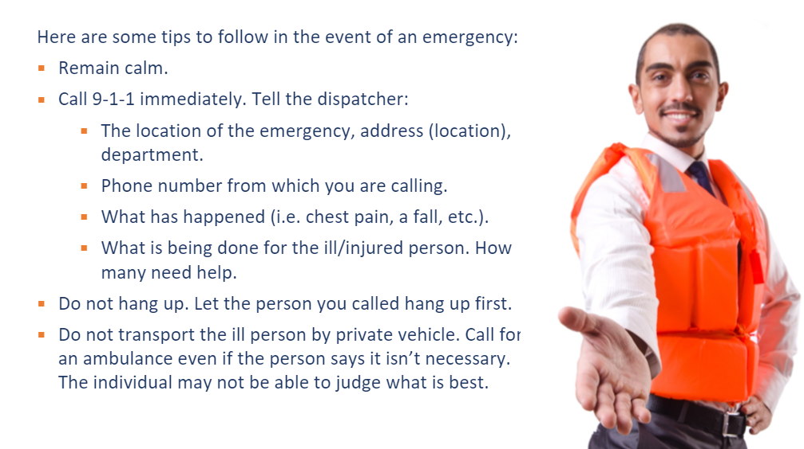
Responding to a Medical Emergency
During a Medical emergency (Ask on-lookers to stand back)
Do not move the ill person, unless necessarily to prevent further injury or death. Make the person as comfortable as possible, right where he/she is. Wait for professional help to move the person.
Notify building management/ Security immediately- to escort medical professionals to the location of the ill person.
Attempt to administer emergency medical care unless trained and certified for CPR, or basic first aid (stop bleeding, keep warm)
Attempt to contact Relatives, Family of the ill person and advise the condition of the person including hospital location if transported.

Slide 15
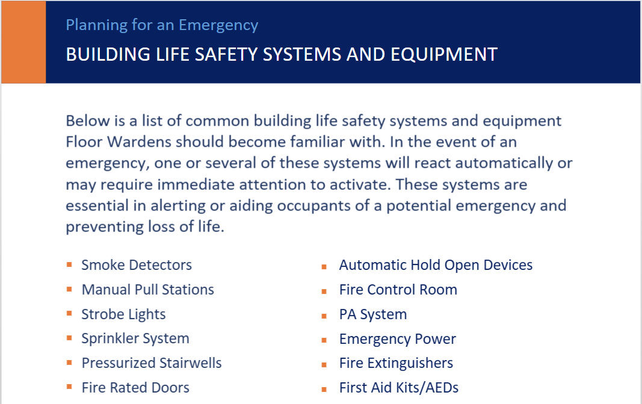
Life Safety Systems & Equipment

Slide 16
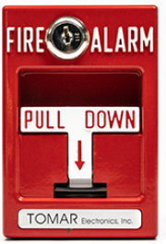
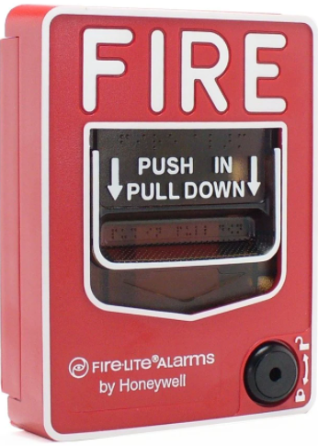
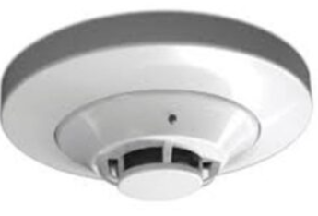
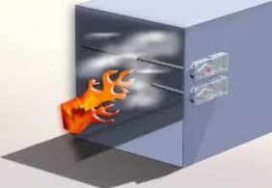
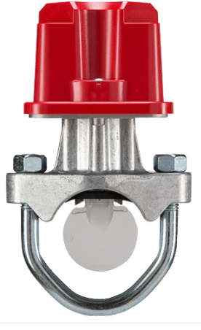
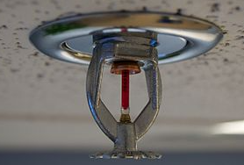
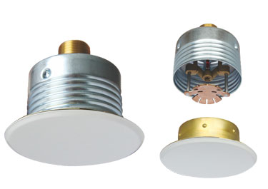
Fire Alarm Systems (Initiating Devices)
Manual Pull Stations
Smoke Alarms
Duct Detectors
Water-flow/tamper Sensors
Fire Sprinkler Devices
Notes:
Red Sprinkler type ratings has a threshold of 155 degrees F. 65 degrees Celcius.
Sprinklers act as a suppressive system for a fire and also activates the water flow sensors in turn activates the alarms.
Smoke detectors also activate with Paint Fumes, dust and vapor- which is why they need to be maintained and clean periodically.

Slide 17
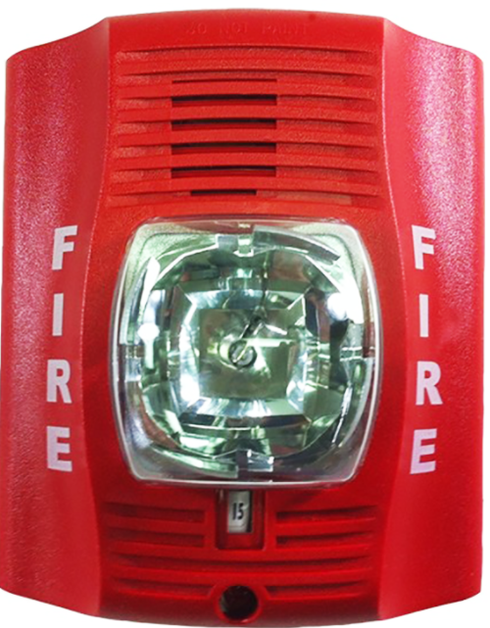
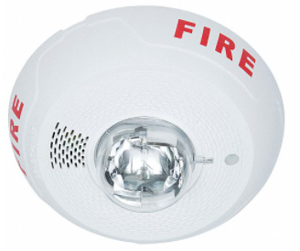
Fire Alarm Systems (Annunciating Devices)
FACP – Display monitor
Strobes – Visual Alarm
Audible alarms Speakers- (Sirens)
Bells
PA System
Notes:
PA system is used for False Alarms or Actual Fire situations to communicate with the building.

Slide 18
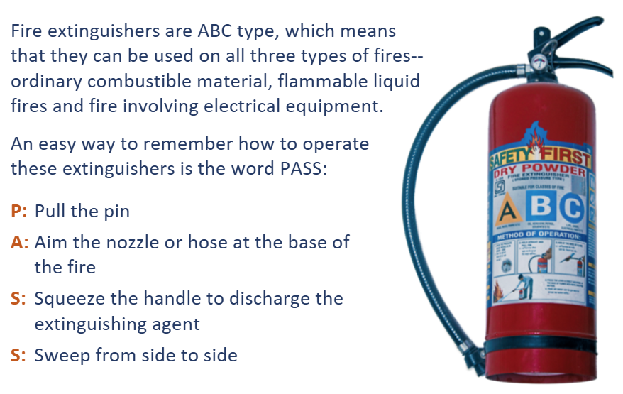
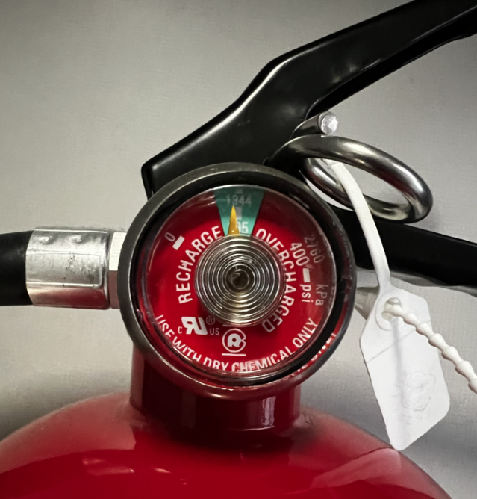
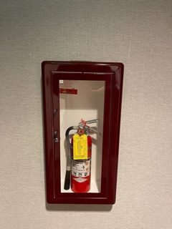
Fire Alarm System (Suppression System)
►Wet-Pipe Sprinkler System / Fire-pump
►Fire Extinguishers
What to look for during inspection:
Are tamper seal & Pin Intact?
Pressure indicator gauge – within compliance in the green zone?
Are Extinguishers accessible on your floor and visible?
How to operate an Extinguisher:
P: Pull the pin
A: Aim the nozzle or hose at the base of the fire
S: Squeeze the handle to discharge the Extinguisher agent
S: Sweep from side to side – give yourself a safe distance while in use.

Slide 19
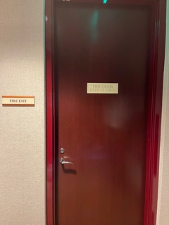
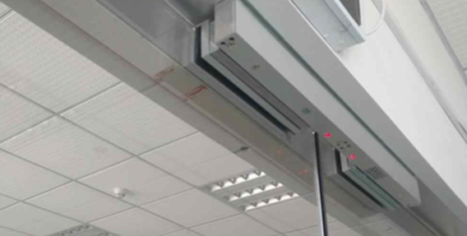
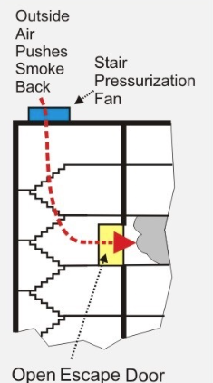
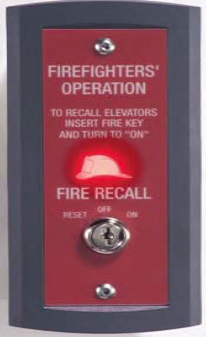
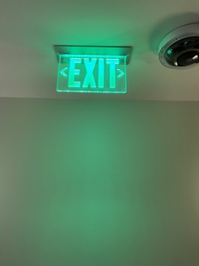
Emergency Fire Relay Systems
Electrified Doors – Fire Exit Doors that are released and unlocked during an active Fire alarm.
Mag Lock Doors – Main entrance doors to office spaces, release the lock during and active Fire alarm.
Stair-wells Pressurized Fans – Pressurized Fans are activated during an active Fire Alarm to ensure proper ventilation and provide oxygen to tenants during an evacuation. Also prevents smoke from entering the stairs.
Elevator Relays- In the event of a fire alarm All elevators will drop to the lobby level in Phase 1 operation for HFD.

Slide 20

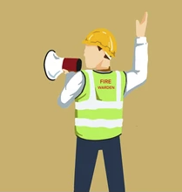
Evacuation Plan (Procedures)
Exiting the Building
Evacuate calmly but quickly through the fire exit stairwells (Do not use elevators).
Fire Wardens, Deputy Fire Warden, Searchers, and Buddies Should exercise leadership and execute their roles.
Occupants should emphasize being quite to hear instructions clearly and cooperate.
Buddies to assist their designated handicapped person to the fire exit stairwell landing or stay in the tenant space and remain with them until emergency personnel/HFD can evacuate handicapped person.
Once floor is clear, Searchers are to check their assigned areas, including restrooms, to ensure all office occupants have exited.
Fire Wardens and searchers must ensure that everyone has exited before evacuating themselves.
Fire Wardens are to direct occupants to immediately report to Assembly location (Hawaii State Capitol Lawn) upon exiting the building.
On Thursday May 22nd, 2025

Slide 21
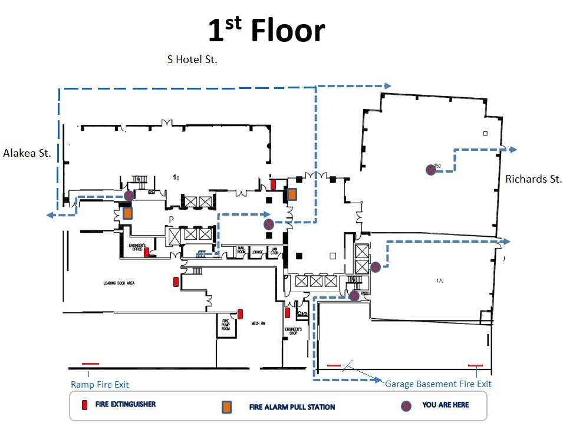
Evacuation Plan (Floor Plans)

Slide 22
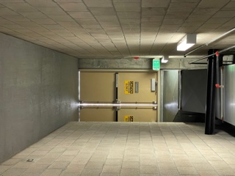
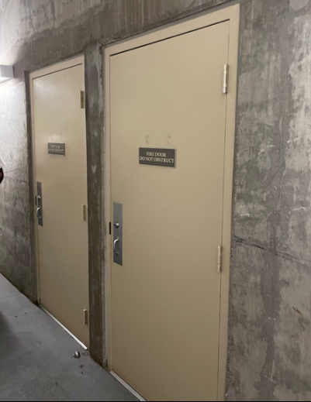
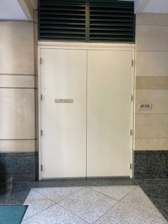
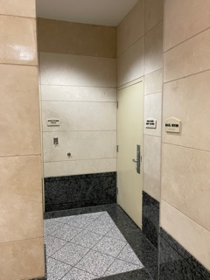
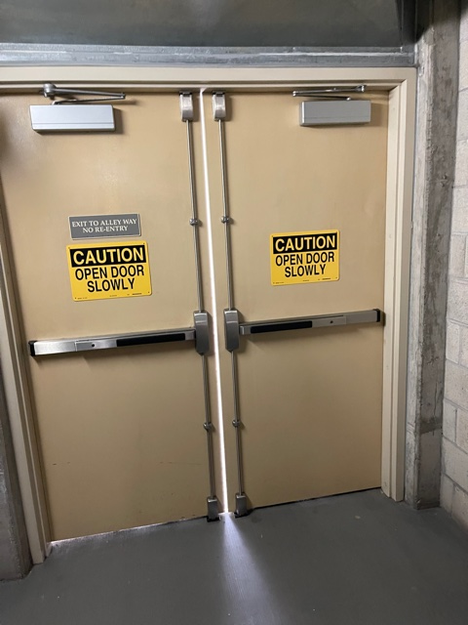
Fire exit (Egress Locations Interior)
Building Fire Exit Door, nearest to Alakea St. Proceed to the sidewalk and continue your route on Hotel St. to Evacuation Zone.
Lobby Level Fire Exit Door, discharges out in lobby, Cross-over through the Hotel St. double glass door.
Makai Garage & Building fire-exit doors. Discharges out near the main fire exit double doors.
Main Fire Exit Double doors. Discharges out to the back alley. Continue your route to Richards St. to evacuation zone. Please use Sidewalk and Crosswalks.

Slide 23
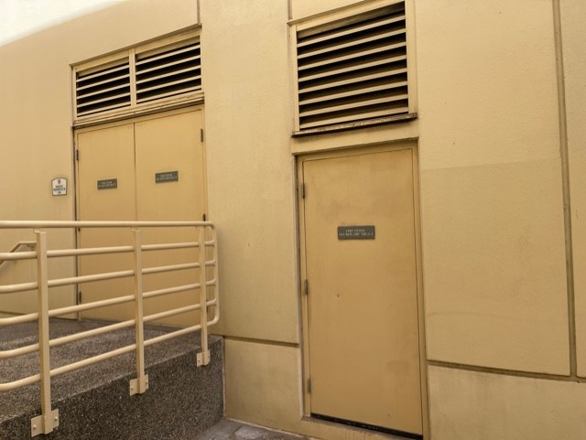
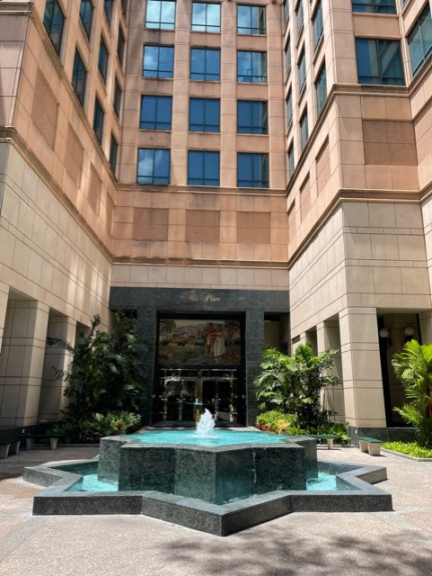
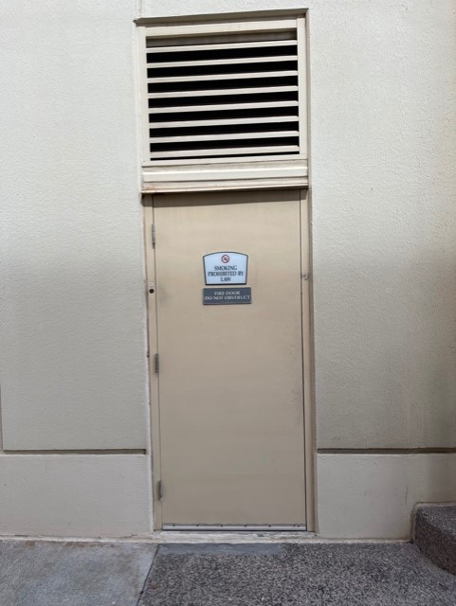
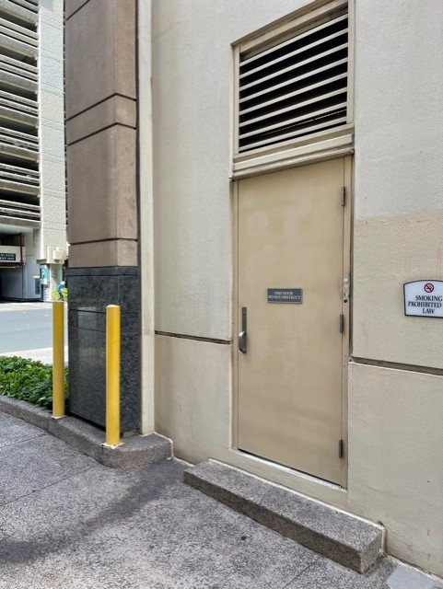
Fire Exit (Egress Locations Exterior)
Main Fire Exit Double Door, Discharges out to the alley. Door to the right is the garage basement fire exit door.
Double Glass door Egress location, discharges out to Hotel St.
Garage Basement Fire Exit Door, discharges out to the alley nearest to Richards St.
Ramp Area Fire Exit Door, Discharges out to the alley nearest to Alakea St.
Main Double Door Fire Exit, discharging out to the alley. Door to the left is the Garage Basement Fire Exit Door.

Slide 24
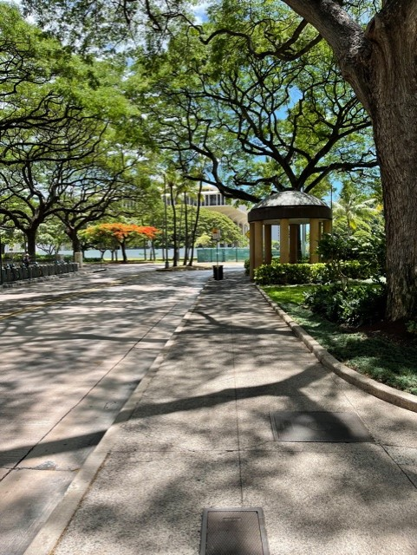
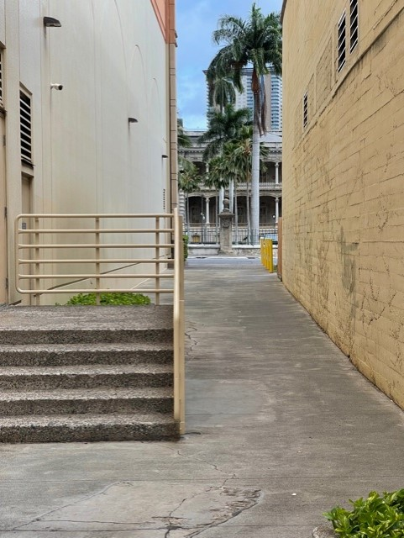
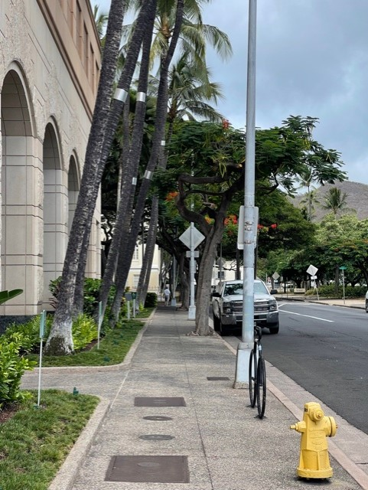
Evacuation (Hotel/Richards St.)
Hotel St. Sidewalk- continue to the crosswalk near the state capitol.
Back Alley – Continue to Richards Street sidewalk.
Richards St. Side-walk - Continue to Crosswalk. Be cognizant of Richards st. parking entrance.

Slide 25
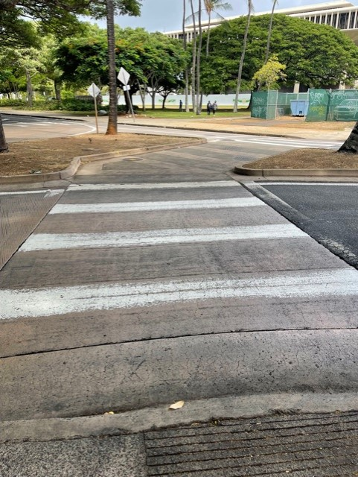
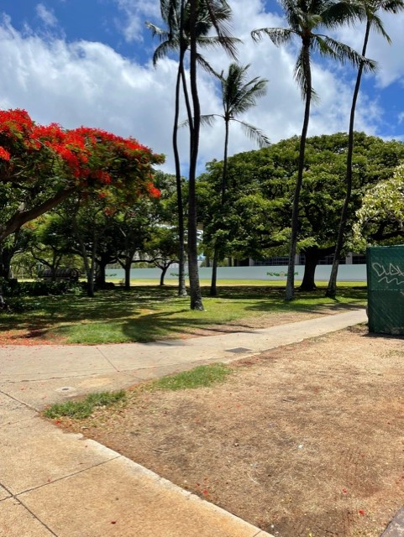
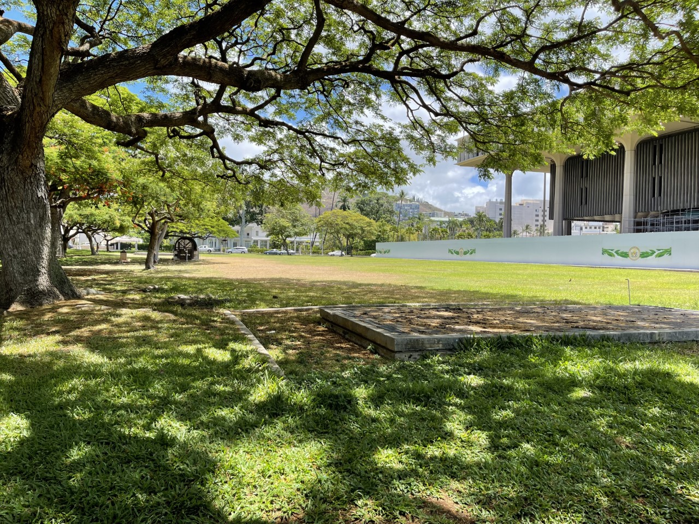
Evacuation Assembly Location
Crosswalk Area Hotel & Richards St.
Entrance to State Capitol Lawn.
Be aware of your surroundings (footing and ground structures.)

Slide 26
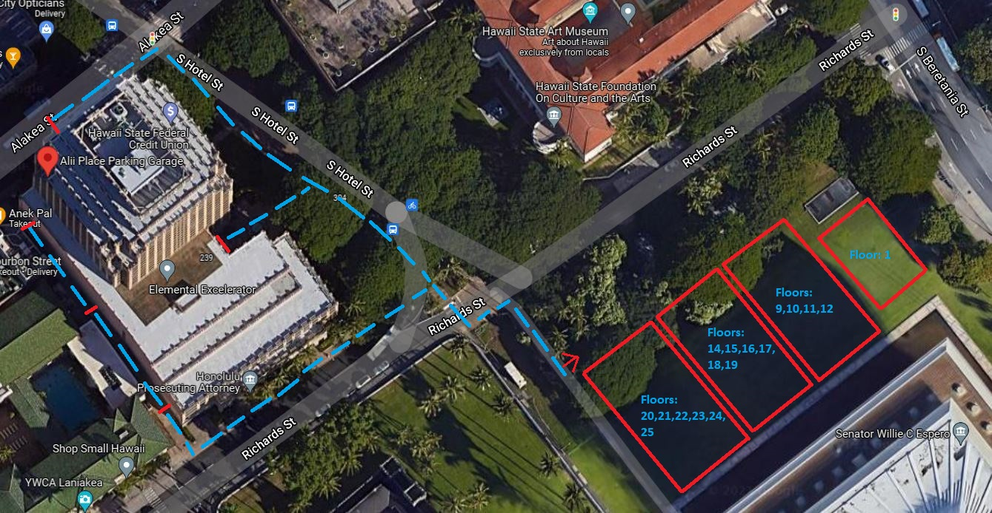
Evacuation Plan (Assembly Route)

Slide 27
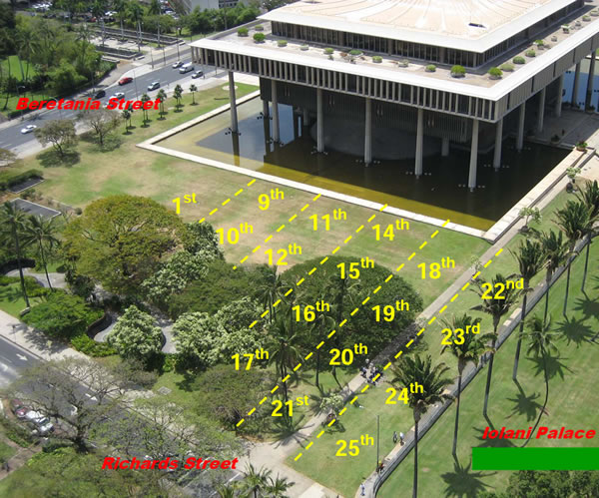
Evacuation Plan (Floor Positions)

Slide 28
Assembly Location Protocols
Area of Safe Refuge – Hawaii State Capitol Lawn
Fire wardens to direct office occupants to Assembly Location and position your group in the appropriate floor positions at the Capitol Lawn.
01
Occupants should not wander or leave the Assembly location and ensure that everyone is accounted for. Keep your respected group together for ease of headcount.
02
Fire Wardens must complete a head count at the Assembly Location with management form provided. This form will be inspected by the Emergency Response Team.
03
If anyone is missing, please report it to the emergency response team and emergency personnel. Please take note of any individuals that are disabled that are at a safe refuge area accompanied by a (buddy)
04
No one should re-enter the building until the Emergency Response Team or HFD have given the all clear.
05

Slide 29
Mahalo for your participation in this year’s Fire-Warden training !
Notes:
We hope that you can take the information provided today to practice fire safety at work and home.

